Slide 1
Presentation
on
Face recognition based attendance system
SUBJECT CODE: MTR-401
Session: July-December 2021
Presented by:
Rahul Singh 18BEM1005
Project Supervisor:
Mr Inderpreet , Assistant Professor
UIE-Department of Mechatronics Engineering

Slide 2
Contents
Introduction
Literature Review
Project Objectives and Details
Code
Early Testing
References
UIE-Department of Mechatronics Engineering

Slide 3
Literature review
S.No. | Author(s) | Type/Title of study: Docking
1 | Maliha Khan; Sudeshna Chakraborty; Rani Astya; Shaveta Khepra-2019 | Face Detection and Recognition Using OpenCV
2 | D. Mary Prasanna 1, Ch. Ganapathy Reddy-2017 | Development of Real Time Face Recognition System Using OpenCV
3 | P Wagner-2012 | Face Recognition with Python
4 | Zankruti Arya1 , Vibha Tiwari-2020 | Automatic Face Recognition and Detection Using OpenCV, Haar Cascade and Recognizer for Frontal Face
5 | R. Padilla, C. F. F. Costa Filho and M. G. F. Costa-2012 | Evaluation of Haar Cascade Classifiers Designed for Face Detection
UIE-Department of Mechatronics Engineering

Slide 4
Literature review
S.No. | Author(s) | Type/Title of study: Docking, Deep Learning & Deep Reinforcement Learning
6 | Michael Gerber & Victor Ruch-2018 | Study on interactive face recognition
7 | Priyanka Pattnaik , Kalyan Kumar Mohanty -2020 | AI-Based Techniques for Real-Time Face Recognition-based Attendance System- A comparative Study
8 | S.AYYAPPAN, Dr.S.MATILDA-2020 | Criminals And Missing Children Identification Using Face Recognition And Web Scrapping
9 | Piyush Kakkar, Mr. Vibhor Sharma-2018 | Criminal Identification System Using Face Detection and Recognition”. International Journal of Advanced Research in Computer and Communication Engineering
10 | Mantoro, T., Ayu, M. A., & Suhendi. -2018 | Multi-Faces Recognition Process Using Haar Cascades and Eigenface Methods” 2018 6th International Conference on Multimedia Computing and Systems
UIE-Department of Mechatronics Engineering

Slide 5
Literature review
S.No. | Author(s) | Type/Title of study: Autonomous Robots
11 | Rehman, Y. A. U., Po, L. M., Liu, M., Zou, Z., Ou, W., & Zhao, Y-2019 | Face liveness detection using convolutional-features fusion of real and deep network generated face images
12 | Ahonen, T., Hadid, A., & Pietikainen, M-2006 | Face description with local binary patterns: Application to face recognition
13 | Lee, K.-C., Ho, J., and Kriegman, D-2005 | Acquiring linear subspaces for face recognition under variable lighting
14 | Rodriguez, Y-2006 | Face Detection and Verification using Local Binary Patterns.
15 | P. Viola and M. Jones,-2008 | Robust real-time object detection," International Journal of Computer Vision
UIE-Department of Mechatronics Engineering

Slide 6
Project Objectives [Software type]:
To learn about the basics and libraries used in face recognition. [completed]
To capture the images from our device. [completed]
To capture the real time image and save it for further process. [completed]
To be able to detect the faces and mark attendance accordingly [completed]

Slide 7

Code

Slide 8

Early Testing:
TYPE 1

Slide 9
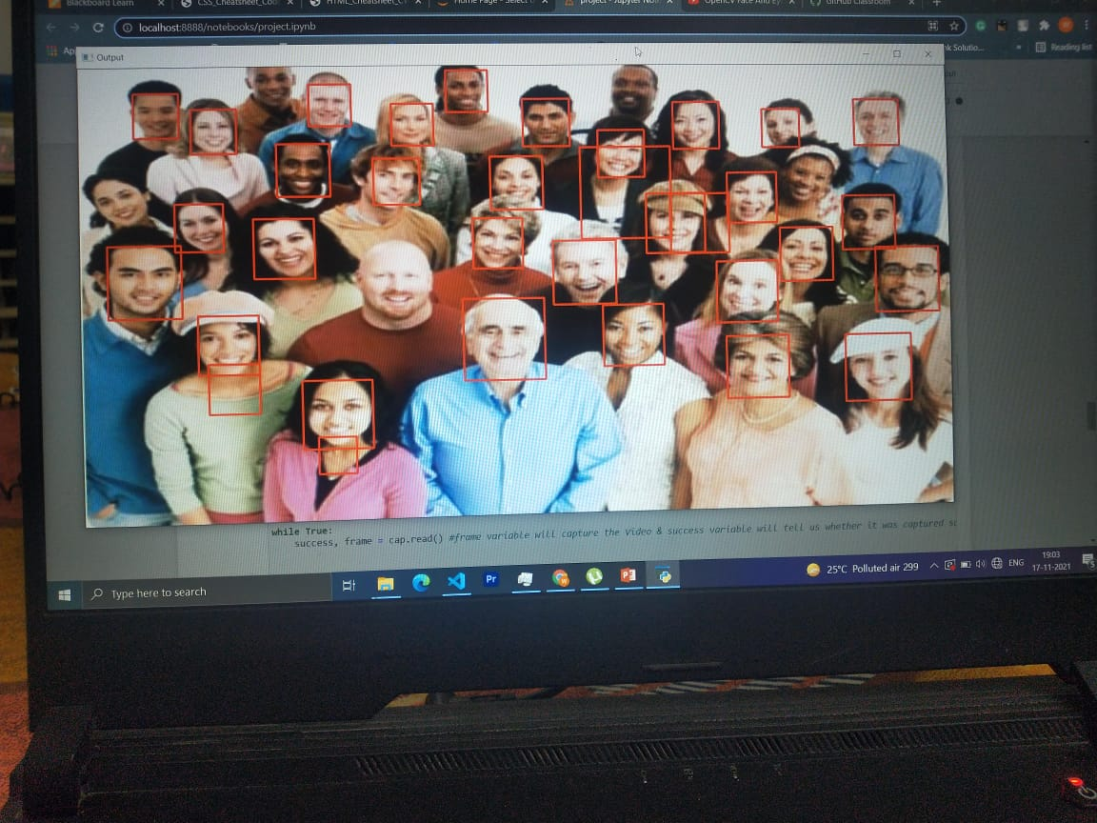
Early Testing:
TYPE 2

Slide 10
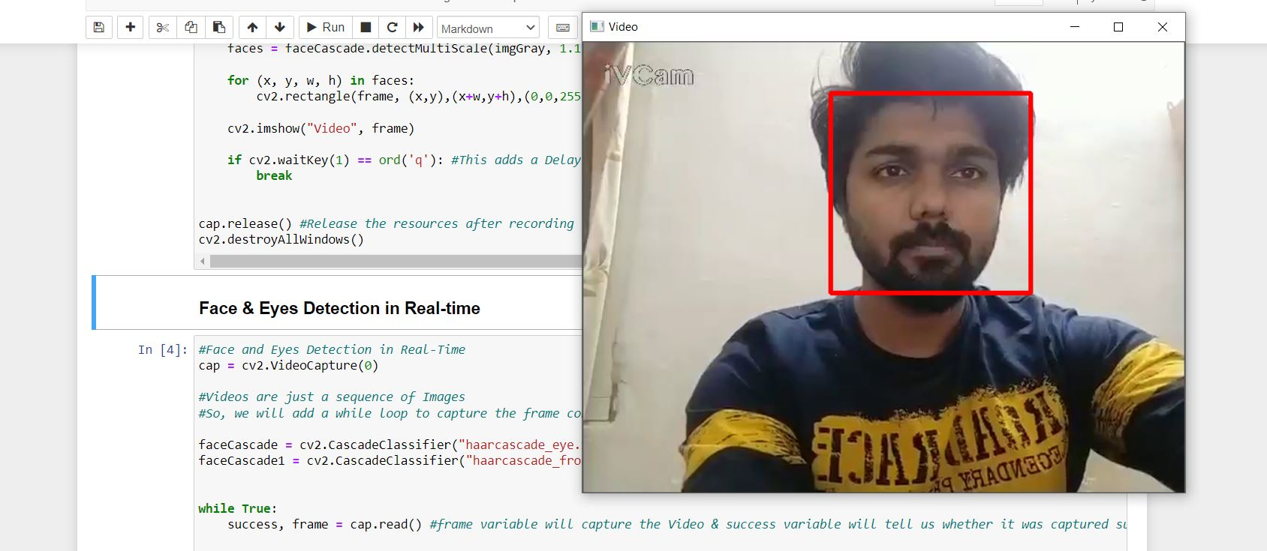
Early Testing:
TYPE 3

Slide 11
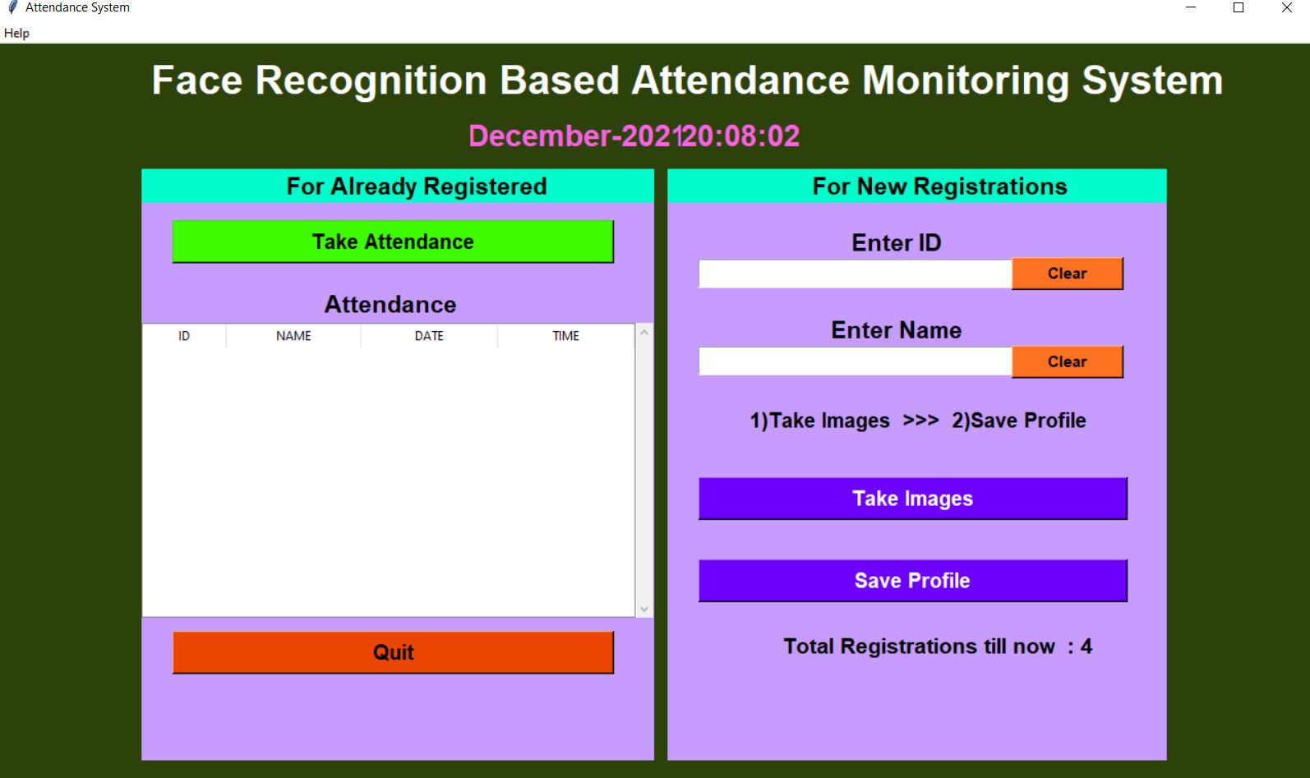
Early Testing:
TYPE 4

Slide 12
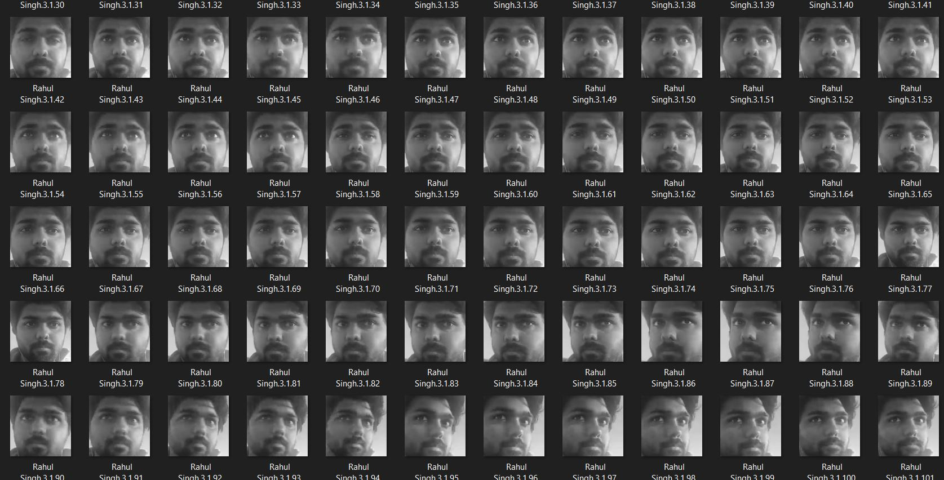
Early Testing:
TYPE 5

Slide 13

Final Testing:
TYPE 6

Slide 14
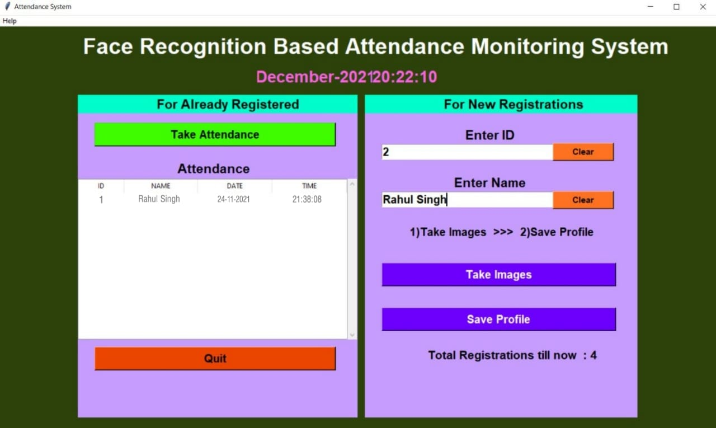
Final Testing:
TYPE 7

Slide 15
Work Done
SR NO. | NAME | WORK DONE
2 | Rahul Singh | Review Papers: Face Detection for picture, video and webcam feed using OpenCv

Slide 16
References
[1] “Haar cascade file[Online] Available: https://github.com/anaustinbeing/haar-cascade-files [Accessed Oct 30, 2021].
[2] “Opencv python ", [Online] Available: https://pypi.org/project/opencv-python/ [Accessed Oct 30, 2021].
[3] “Documentation on open cv python", [Online] Available: https://docs.opencv.org/4.x/d6/d00/tutorial_py_root.html [Accessed Oct 30, 2021].
[4] “Tkinter python", [Online] Available: https://docs.python.org/3/library/tkinter.html [Accessed Nov 2, 2021].
UIE-Department of Mechatronics Engineering

Slide 17
THANK YOU
UIE-Department of Mechatronics Engineering

